Slide 1
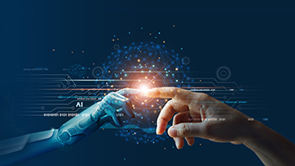
My AI Journey
Jazmine Brown | ITAI 2376 | Spring 2025
Patricia McManus

Slide 2

Module 2: JAX vs NumPy
JAX offers automatic differentiation and JIT compilation for ML.
Runs on GPUs/TPUs vs. NumPy's CPU-focused design.
Ideal for large-scale, performance-intensive applications.

Slide 3
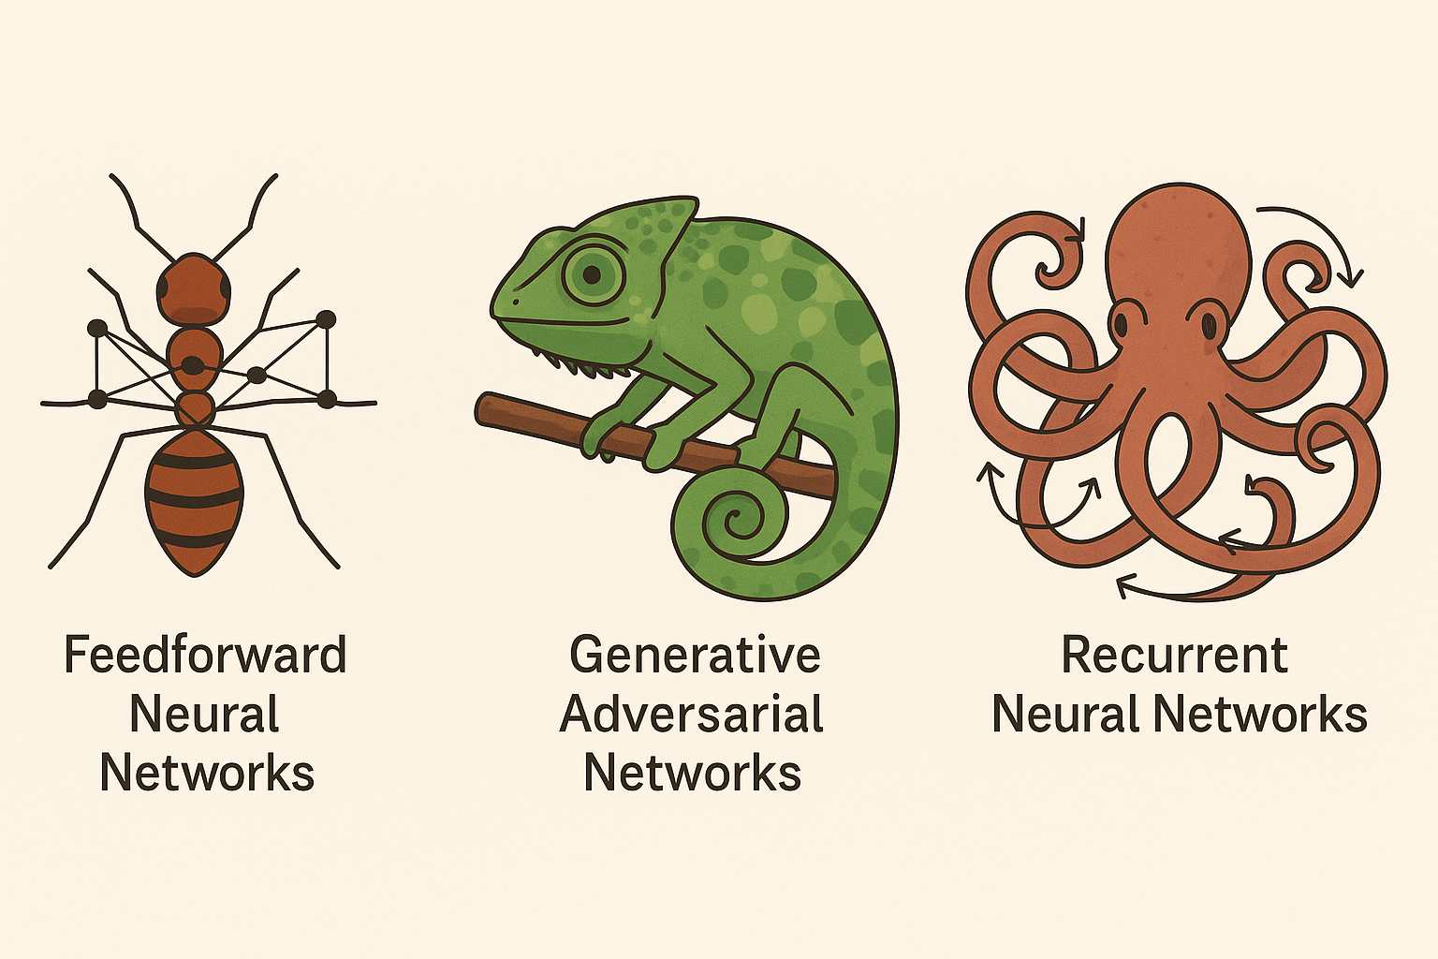
Module 3: Neural Network Zoo
Ants (Feedforward NNs): Simple, layered, cooperative structure.
Chameleon (GANs): Generate realistic outputs via adversarial training.
Octopus (RNNs): Memory-based, cyclical data processing.

Slide 4
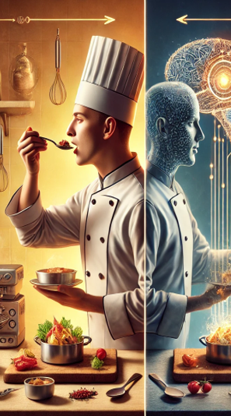
Module 4: Chef AI – Backpropagation
Used cooking analogy to explain forward/backward passes.
Included interactive voting on recipe changes to simulate learning.
Connected to real-world AI applications like recommendation systems.

Slide 5
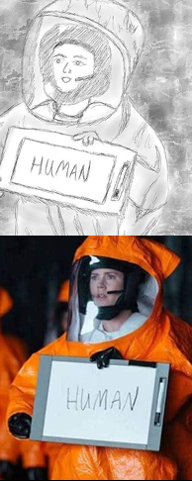

Module 5: NLP & Linguistic Relativity
Arrival film explores Sapir-Whorf hypothesis and non-linear language.
Illustrated real-world NLP issues: ambiguity, cultural context.
Compared rule-based NLP vs. deep learning and transformer models.

Slide 6
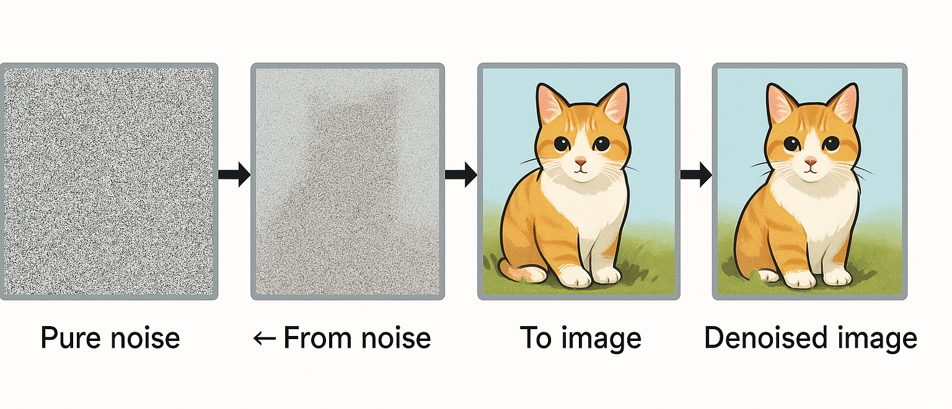
Midterm: Diffusion Model Project
Gradual noise removal taught model to generate clear images.
Used U-Net with skip connections and dual conditioning (time + class).
CLIP evaluation measured clarity vs. blurry predictions effectively.

Slide 7
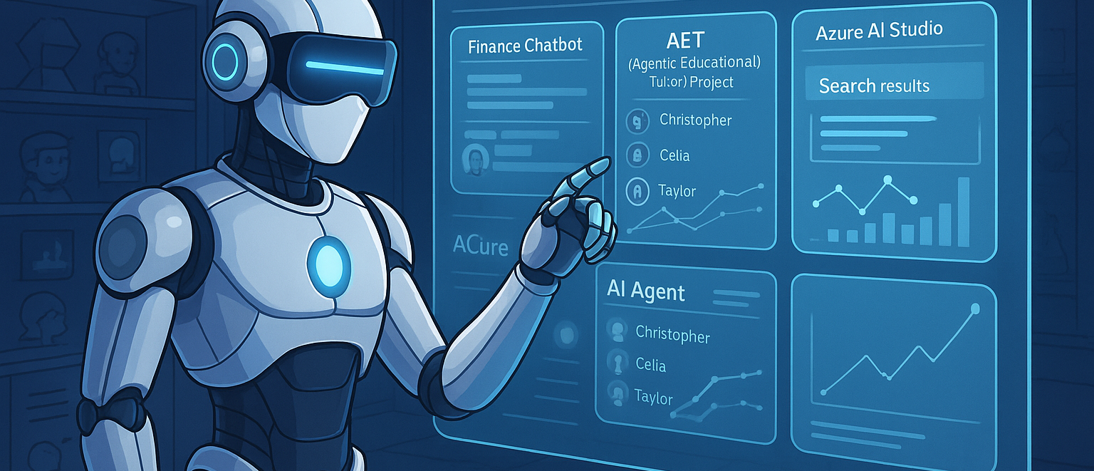
Final Project: AI Research Assistant Agent
Automated research assistant for citations, search, summarization.
90% retrieval rate, 85% user satisfaction, built with Azure & Python.
Uses RL to improve via feedback; scalable, modular system.

Slide 8
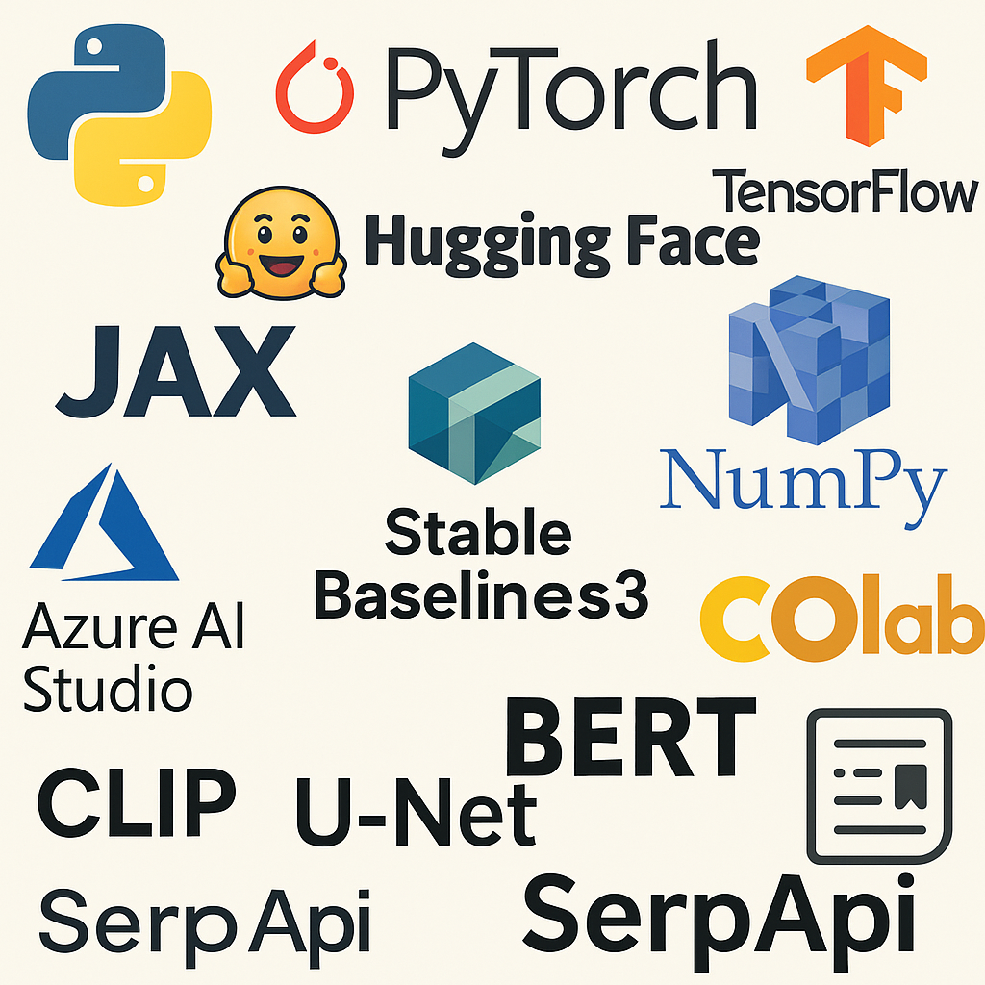
Key Tools and Technologies
Python, PyTorch, TensorFlow, Hugging Face, JAX, NumPy.
Azure AI Studio, Stable Baselines3, Google Colab.
CLIP, U-Net, BERT, SerpAPI, citation libraries.

Slide 9

Takeaways & Reflections
Hands-on experience building AI from theory to practice.
Improved collaboration, problem-solving, and research fluency.
Gained deeper understanding of RL, NLP, CNNs, and ML ecosystems.

Slide 10
Thank You!
Presentation by Jazmine Brown
Visit my GitHub for full portfolio and projects:
https://github.com/JAB0987/ITAI2376_Portfolio_JazmineB

